Slide 1
Internship presentation
Name - Malay patil
Seat no - 0120170379
Roll no – t194070

Slide 2
Problem Statement
Image Stenography:
The techniques for secret hiding of messages in an otherwise innocent looking carrier message belong to the field of steganography. The purpose of steganography is to conceal the very presence of secret information. To make the communication more secure, the secret information can be compressed and encrypted before it is hidden in the carrier. This is important because in this way we minimize the amount of information that is to be sent, and it is also easier to hide a random looking message into the carrier than to hide a message with a high degree of regularity. Encrypting the compressed message before hiding is recommended and provides double protection

Slide 3
Work done :
week-1:
encryption of message using base64
study for PIL (python image library)
week-2:
main page GUI development completed
file handling
completed upto hiding message function
week-3:
decryption function created
removed small bugs from frames
week-4:
GUI completed.
arranged code in classes for better understanding

Slide 4
Software Requirements
python3 - coding language
libraries:
PILLOW - pillow is a fork of PIL (Python Image Library) to perform different operations like changing format, resolution, modifying pixels, etc.
BASE64 - basse64 is python’s inbuilt library to convert normal message into base64 encrypt format, base64 provides faster encryption and decryption.
TKINTER – “tkinter” or “tk” is python library for creating GUIs (graphical user interface).

Slide 5
Basic Working
encode:
select any image.
this image is converted into png format.
your massage taken from text box converted to base64.
merge this base64 encoded string with image.
user is given option to save image wherever he/she wants.
decode:
select image which is encoded.
the base64 string is separated using decode function.
base64 string is decoded.
by tkinter the output is shown in a textbox.

Slide 6
Logic
Suppose the message to be hidden is “Hii”. Since the message is of 3-bytes, therefore, pixels required to encode the data is 3 x 3 = 9. Consider a 4 x 3 image with a total 12-pixels, which are sufficient to encode the given data.
[(27, 64, 164), (248, 244, 194), (174, 246, 250), (149, 95, 232), (188, 156, 169), (71, 167, 127), (132, 173, 97), (113, 69, 206), (255, 29, 213), (53, 153, 220), (246, 225, 229), (142, 82, 175)]
ASCII value of ‘ H ‘ is 72 whose binary equivalent is 01001000.
Taking first 3-pixels
(27, 64, 164), (248, 244, 194), (174, 246, 250) to encode.
Now change the pixel to odd for 1 and even for 0. So, the modifies pixels are
(26, 63, 164), (248, 243, 194), (174, 246, 250).
Since we have to encode more data, therefore, the last value should be even. Similarly, ‘i‘ can be encoded in this image

Slide 7
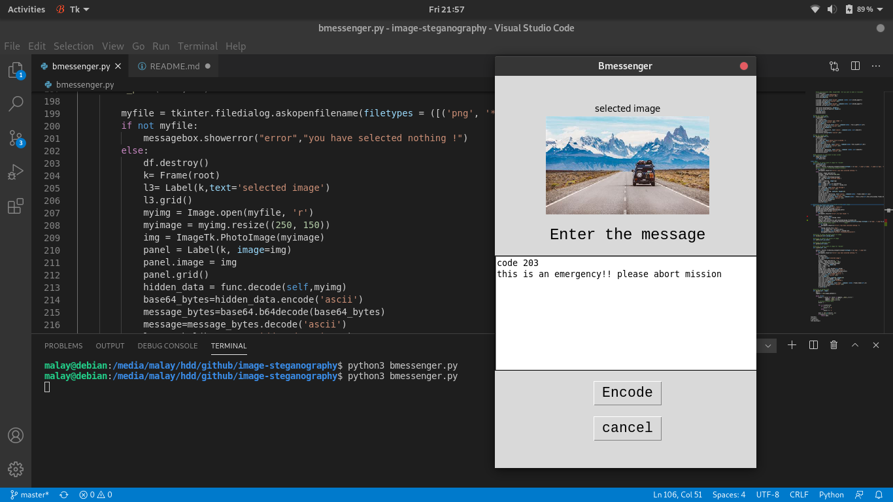
Application UI

Slide 8
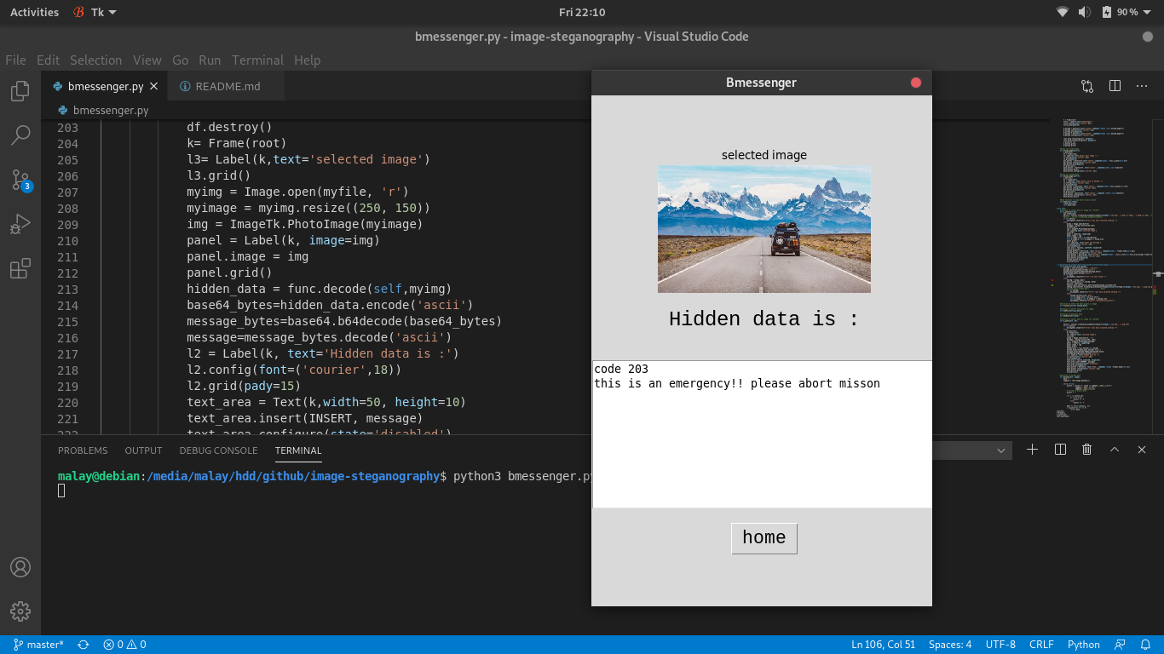

Slide 9
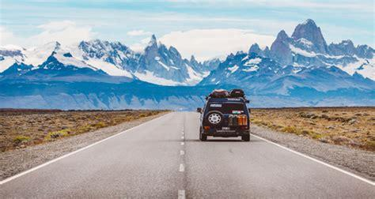
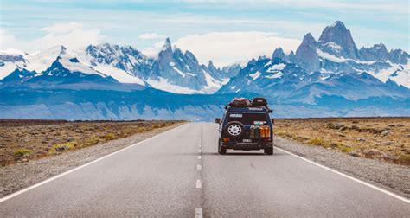
Comparing both image
Normal image edited image

Slide 10
conclusion
This project helped me to learn GUI for application and also I have gathered knowledge of steganography and I understood how to implement it using python image library and also learned to construct code properly.

Slide 11
References:
https://www.geeksforgeeks.org/image-based-steganography-using-python/
https://docs.python.org/3/library/tkinter.html
https://pillow.readthedocs.io/en/stable/
https://docs.python.org/3/library/base64.html

